Slide 1
Web presentation

Slide 2
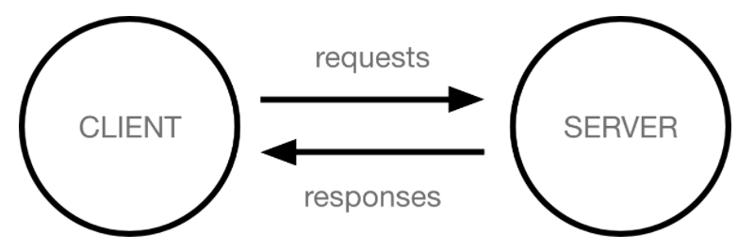
How the Web Works
The browser sends an HTTP request message to the server, asking it to send a copy of the website to the client. This message, and all other data sent between the client and the server, is sent across your internet connection using TCP/IP.

Slide 3
What do you need to be a web developer
There are no formal or specific qualifications required to become a web developer.
You should also ideally have an aptitude for elements such as:
Frontend web programing languages and skills such as JavaScript, Ajax and web animation techniques
User experience (UX)
Coding languages including HTML and CSS
User interface (UI)
Backend web programing languages such as C# or Java, PHP and Ruby

Slide 4
What is the role of a web developer.
Also known as web programmers or web coders, web developers essentially make a website work by building the functionality, interactivity and visible structure of the site, normally based on the vision of designers and other key roles.
Web developers are also responsible for ensuring a site functions correctly on all browsers - both desktop and mobile - through testing. Once a site is live, a developer carries out updates and other maintenance tasks as necessary.

